Slide 1
Chapter 1: Introduction
Notes:
Logical cores are the number of Physical cores times the number of threads that can run on each cores. This is known as HyperThreading. ... You should now understand that if your computer has 2 physical cores, and can run 2 threads per core, then you have 4 logical processors.

Slide 2
What is an Operating System?
What is an Operating system?
  A program that acts as an intermediary between a user of a computer and the computer hardware.
  Resource allocator
  Control Program
Operating system goals:
  Execute user programs and make solving user problems easier
  Make the computer system convenient to use
  Use the computer hardware in an efficient manner
An operating system is the one program that is running at all the times on the computer- usually called the kernel.(System programs and application programs)
Notes:
Operating System can be defined as an interface between user and the hardware. It provides an environment to the user so that, the user can perform its task in convenient and efficient way.
In the Computer System (comprises of Hardware and software), Hardware can only understand machine code (in the form of 0 and 1) which doesn't make any sense to a naive user.
We need a system which can act as an intermediary and manage all the processes and resources present in the system.
The purpose of an operating system is to provide an environment in which a user can execute programs in convenient and efficient manner.

Slide 3
Computer System Structure
Computer system can be divided into four components
  Hardware – provides basic computing resources
    CPU, memory, I/O devices
  Operating system
    Controls and coordinates use of hardware among various applications and users
  Application programs – define the ways in which the system resources are used to solve the computing problems of the users
    Word processors, compilers, web browsers, database systems, video games
  Users
    People, machines, other computers

Slide 4

Four Components of a Computer System
Notes:
The system programs are used to program the operating system software. While application programs provide software that is used directly by the user, system programs provide software that are used by other systems such as SaaS applications, computational science applications etc.
A Computer System consists of:
Users (people who are using the computer)
Application Programs (Compilers, Databases, Games, Video player, Browsers, etc.)
System Programs (Shells, Editors, Compilers, etc.)
Operating System ( A special program which acts as an interface between user and hardware )
Hardware ( CPU, Disks, Memory, etc)

Slide 5
Operating System Definition
To understand more fully the OS role, we explore OS from 2 view points.:
User view: In single user, it should be easy to use.
System View:
OS is a resource allocator
  Manages all resources
  Decides between conflicting requests for efficient and fair resource use
OS is a control program
  Controls execution of programs to prevent errors and improper use of the computer
Notes:
kernel is the foundational layer of an operating system (OS). It functions at a basic level, communicating with hardware and managing resources, such as RAM and the CPU. ... The kernel performs a system check and recognizes components, such as the processor, GPU, and memory. It also checks for any connected peripherals.
In other cases, where users access the same user through different terminals, More emphasize is on resource allocation and utilization.

Slide 6
Operating-System Operations
Dual-mode operation allows OS to protect itself and other system components
  User mode and kernel mode
  Mode bit provided by hardware
    Provides ability to distinguish when system is running user code or kernel code
    Some instructions designated as privileged, only executable in kernel mode
    System call changes mode to kernel, return from call resets it to user
Notes:
The main difference between System Call and Interrupt is that System Call is a method that allows a program to request services from the kernel while Interrupt is an event that indicates the CPU to perform a specific task immediately.
A system call is call by software running on the OS to services provided by the OS.
An interrupt is usually external hardware component notifying the CPU/Microprocessor about an event that needs handling in software (usually a driver).
Modern OS s are Interrupt driven. If no process, no I/o devices, No users Os will sit quietly waiting for some event to occur.
Hardware generates interrupt and.. Program or software send generate events by using system calls. Error or request by a software creates exception or trap
Division by zero, request for operating system service
Since OS and users share h/w, s/w resources, we make to sure that an error in a program does not affect any other program.
In order to ensure the proper execution of the operating system, we must be
able to distinguish between the execution of operating-system code and userdefined
code. The approach taken by most computer systems is to provide
hardware support that allows us to differentiate among various modes of
execution.

Slide 7

Transition from User to Kernel Mode
Notes:
At the very least we need two separate modes of operation :user mode
and kernel mode (also called or supervisor mode or privileged mode)
A bit, called the mode bit is added to the hardware of the computer to
indicate the current mode: kernel (0) or user (1). With the help of mode bit you can distinguish between a task that is executed on behalf of the operating system
, When thee computer system is executing on behalf of a user application, the system is in user mode. However,
when a user application requests a service from the operating system (via a
.. system call), it must transition from user to kernel mode to fulfill the request.
At system boot time, the hardware starts in kernel mode. The operating
system is then loaded and starts user applications in user mode. Whenever a
trap or interrupt occurs, the hardware switches from user mode to kernel mode
(that is, changes the state of the mode bit to 0). Thus, whenever the operating
system gains control of the computer, it is in kernel mode. The system always
switches to user mode (by setting the mode bit to 1) before passing control to
a user program.
The dual mode of operation provides us with the means for protecting the
operating system from errant users-and errant users from one another. We
Accomplish this protection by designating some of the machine instructions that may cause harm as privileged instructions. The hardware allows privileged instructions to be executed only in kernel mode. If an attempt is made to
execute a privileged instruction in user mode, the hardware does not execute
the instruction but rather treats it as illegal and traps it to the operating system.
The instruction to switch to kernel mode is an example of a privileged
instruction. Some other examples include I/0 control, timer management and
interrupt management.

Slide 8

Computer System Organization
Computer-system operation
  One or more CPUs, device controllers connect through common bus providing access to shared memory
  Concurrent execution of CPUs and devices competing for memory cycles

Slide 9
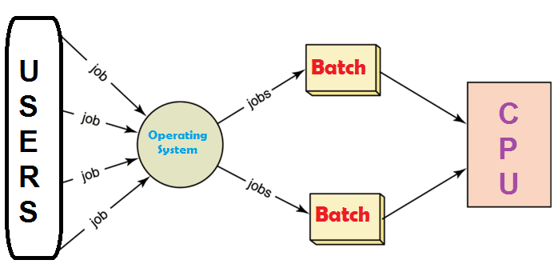
TYPES OF OS: Batch Systems
Notes:
Early computers were Physically enormous machines run from a console
The common input devices were card readers and tape drives.
The common output devices were line printers, tape drives, and card punches.
The user did not interact directly with the computer systems. Rather, the user prepared a job -which consisted of the program, the data, and some control information about the nature of the job (control cards)-and submitted it to the computer operator. The job was usually in the form of punch cards. At some later time (after minutes, hours, or days), the output appeared.
To speed up processing, operators batched together jobs with similar needs and ran them through the computer as a group.
The programmers leave their programs with the operator and the operator then sorts the programs with similar requirements into batches.
The problems with Batch Systems are as follows −
Lack of interaction between the user and the job.
CPU is often idle, because the speed of the mechanical I/O devices is slower than the CPU.
Difficult to provide the desired priority.

Slide 10
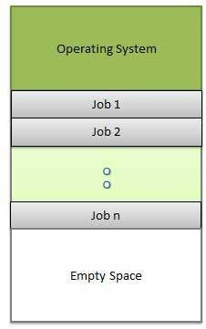
Multiprogrammed OS

Slide 11
Multiprogrammed OS
  needed for efficiency
  Single user cannot keep CPU and I/O devices busy at all times
  Multiprogramming organizes jobs (code and data) so CPU always has one to execute
  A subset of total jobs in system is kept in memory
  One job selected and run via job scheduling
  When it has to wait (for I/O for example), OS switches to another job
Notes:
Sharing the processor, when two or more programs reside in memory at the same time, is referred as multiprogramming. Multiprogramming assumes a single shared processor.
Multiprogramming increases CPU utilization by organizing jobs so that the CPU always has one to execute.
An OS does the following activities related to multiprogramming.
The operating system keeps several jobs in memory at a time.
This set of jobs is a subset of the jobs kept in the job pool.
The operating system picks and begins to execute one of the jobs in the memory.
Multiprogramming operating systems monitor the state of all active programs and system resources using memory management programs to ensures that the CPU is never idle, unless there are no jobs to process.
Advantages
High and efficient CPU utilization.
User feels that many programs are allotted CPU almost simultaneously.
Disadvantages
CPU scheduling is required.
To accommodate many jobs in memory, memory management is required.

Slide 12
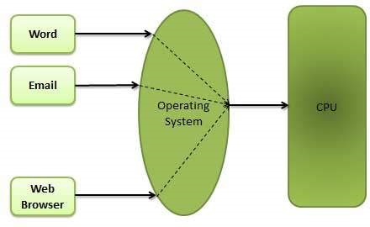
Time Sharing Systems

Slide 13
Timesharing OS
Timesharing (multitasking) is logical extension in which CPU switches jobs so frequently that users can interact with each job while it is running, creating interactive computing
  Each user has at least one program executing in memory process
  If several jobs ready to run at the same time  CPU scheduling
  If processes don’t fit in memory, swapping moves them in and out to run
  Virtual memory allows execution of processes not completely in memory
Notes:
Multitasking is when multiple jobs are executed by the CPU simultaneously by switching between them. Switches occur so frequently that the users may interact with each program while it is running. An OS does the following activities related to multitasking −
The user gives instructions to the operating system or to a program directly, and receives an immediate response.
The OS handles multitasking in the way that it can handle multiple operations/executes multiple programs at a time.
Multitasking Operating Systems are also known as Time-sharing systems.
These Operating Systems were developed to provide interactive use of a computer system at a reasonable cost.
A time-shared operating system uses the concept of CPU scheduling and multiprogramming to provide each user with a small portion of a time-shared CPU.
Each user has at least one separate program in memory.

Slide 14
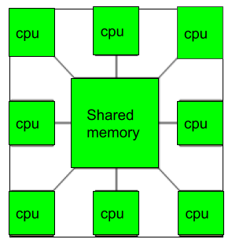
Multiprocessing OS
Notes:
A Multiprocessor is a computer system with two or more central processing units (CPUs) share full access to a common RAM. The main objective of using a multiprocessor is to boost the system’s execution speed, with other objectives being fault tolerance and application matching.
There are two types of multiprocessors, one is called shared memory multiprocessor and another is distributed memory multiprocessor. In shared memory multiprocessors, all the CPUs shares the common memory but in a distributed memory multiprocessor, every CPU has its own private memory.

Slide 15
Multiprocessing OS
Most systems to date are single-processor systems; that is, they have only one main CPU.
However, multiprocessor systems (also known as parallel systems ) are growing in importance.
Such systems have more than one processor in close communication, sharing the computer bus, the clock, and sometimes memory and peripheral devices.
Multiprocessor systems have three main advantages:
Increased throughput.
Economy of scale.
Increased reliability.
Notes:
Types of Multiprocessors
There are mainly two types of multiprocessors i.e. symmetric and asymmetric multiprocessors. Details about them are as follows −
Symmetric Multiprocessors
In these types of systems, each processor contains a similar copy of the operating system and they all communicate with each other. All the processors are in a peer to peer relationship i.e. no master - slave relationship exists between them.
An example of the symmetric multiprocessing system is the Encore version of Unix for the Multimax Computer.
Asymmetric Multiprocessors
In asymmetric systems, each processor is given a predefined task. There is a master processor that gives instruction to all the other processors. Asymmetric multiprocessor system contains a master slave relationship.
Asymmetric multiprocessor was the only type of multiprocessor available before symmetric multiprocessors were created. Now also, this is the cheaper option.
Advantages of Multiprocessor Systems
There are multiple advantages to multiprocessor systems. Some of these are −
More reliable Systems
In a multiprocessor system, even if one processor fails, the system will not halt. This ability to continue working despite hardware failure is known as graceful degradation. For example: If there are 5 processors in a multiprocessor system and one of them fails, then also 4 processors are still working. So the system only becomes slower and does not ground to a halt.
Enhanced Throughput
If multiple processors are working in tandem, then the throughput of the system increases i.e. number of processes getting executed per unit of time increase. If there are N processors then the throughput increases by an amount just under N.
More Economic Systems
Multiprocessor systems are cheaper than single processor systems in the long run because they share the data storage, peripheral devices, power supplies etc. If there are multiple processes that share data, it is better to schedule them on multiprocessor systems with shared data than have different computer systems with multiple copies of the data.
Disadvantages of Multiprocessor Systems
There are some disadvantages as well to multiprocessor systems. Some of these are:
Increased Expense
Even though multiprocessor systems are cheaper in the long run than using multiple computer systems, still they are quite expensive. It is much cheaper to buy a simple single processor system than a multiprocessor system.
Complicated Operating System Required
There are multiple processors in a multiprocessor system that share peripherals, memory etc. So, it is much more complicated to schedule processes and impart resources to processes.than in single processor systems. Hence, a more complex and complicated operating system is required in multiprocessor systems.
Large Main Memory Required
All the processors in the multiprocessor system share the memory. So a much larger pool of memory is required as compared to single processor systems.

Slide 16
Distributed Systems
A network, in the simplest terms, is a communication path between two or more systems. Distributed systems depend on networking for their functionality. By being able to communicate, distributed systems are able to share computational tasks, and provide a rich set of features to users.
CLIENT SERVER SYSTEMS
PEER TO PEER SYSTEMS
Notes:
A DOS is a system which contains multiple components located on different machines, which coordinate and communicate actions in order to appear as a single coherent working system to the user.
A distributed operating system (DOS), are systems which model where distributed applications are running on multiple computers, linked by communications.
Processors in a DOS communicate with each other through various communication lines like high-speed buses
In a DOS the following occurs:
All software and hardware compounds are located remotely. In order for them to communicate with each other, they pass messages.
One of the most important aspects of a distributed system is resource sharing. Resources are managed by servers and clients use these resources.
A DOS runs on a number of independent sites which are connected through a communication network. However it is portrayed to the user that they run their own operating system.
Client-server:
This type of system requires the client to request a resource, and then the server provides that resource which was requested. When a client is in contact with one server, the server itself may serve multiple clients at the same time.
Both the server and the client will communicate over a computer network, which is part of a distributed system
Peer-to-peer:
This type of system contains nodes that are equal participants in data sharing, furthermore, all the tasks are equally divided between all the nodes. These nodes will interact with each other as required as “share resources”. To accomplish this, a network is needed.

Slide 17
Embedded systems:
→Embedded computers are most prevalent form of computers in existence.
→these are found everywhere ex: robots, microwave oven. Now a days entire house can be made computerized. Used in alarm systems, coffee makers, CCTV cameras etc. They tend to have specific tasks.
→OS has limited features.
→ have little user interface.
these systems run Real time OS.
Rigid time constraints. Processing must be done within that time constraint.
Used as a control device for a specific application.
Notes:
An embedded operating system (OS) is a specialized operating system designed to perform a specific task for a device that is not a computer. An embedded operating system’s main job is to run the code that allows the device to do its job. The embedded OS also makes the device’s hardware accessible to the software that is running on top of the OS.
An embedded system is a computer that supports a machine. Examples include computers in cars, traffic lights, digital televisions, ATMs, airplane controls, point of sale (POS) terminals, digital cameras, GPS navigation systems, elevators, digital media receivers and smart meters, among many other possibilities.
Examples of embedded OS
Many modern electronic devices are based on Arduino or Raspberry PI. Raspberry PI devices often run an ARM-based Linux kernel, but there are actually a number of different operating systems that can be run on Raspberry PI devices. Arduino devices have a much more primitive embedded operating system that acts as little more than a boot loader and a command interpreter.

Slide 18
Handheld systems:
Include PDAs(Personal digital assistants). Such as palm and pocket PCs, cell phones.
More challenging.
Limited size, weight.
Small memory, slow processor, small display screens.
Only a small subset of web page is displayed on the handheld device. Known as web clipping
Notes:
Handheld systems include Personal Digital Assistants(PDAs), such as Palm-Pilots or Cellular Telephones with connectivity to a network such as the Internet. They are usually of limited size due to which most handheld devices have a small amount of memory, include slow processors, and feature small display screens.

Slide 19
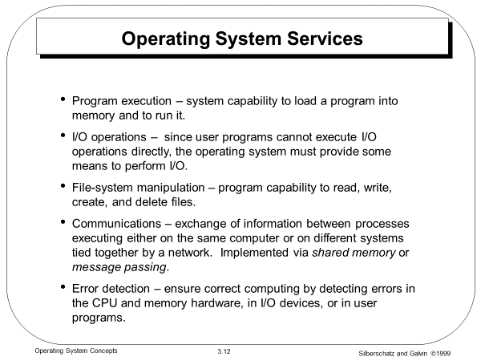


Slide 20
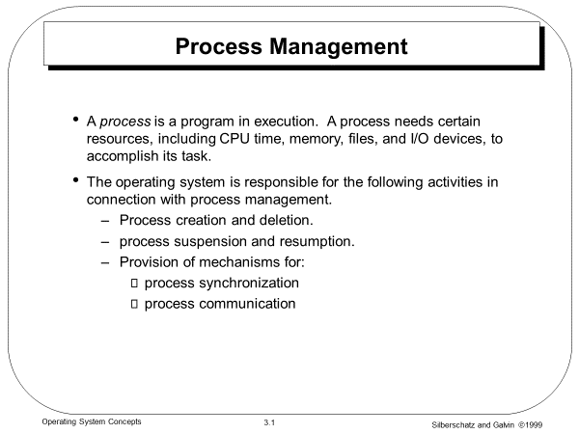

Slide 21
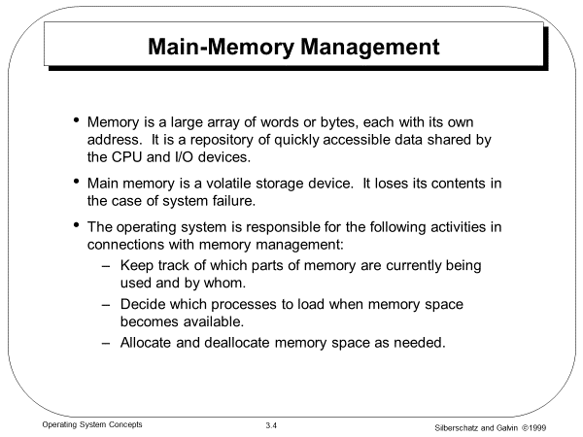

Slide 22
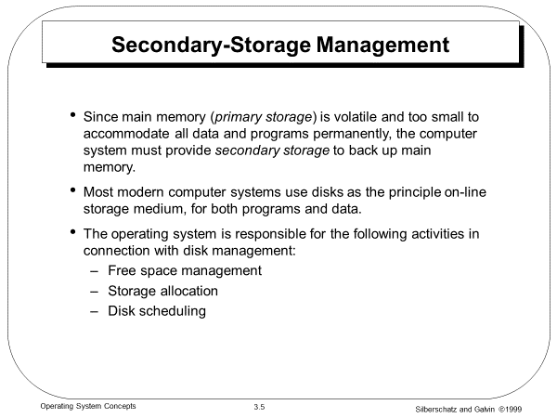

Slide 23
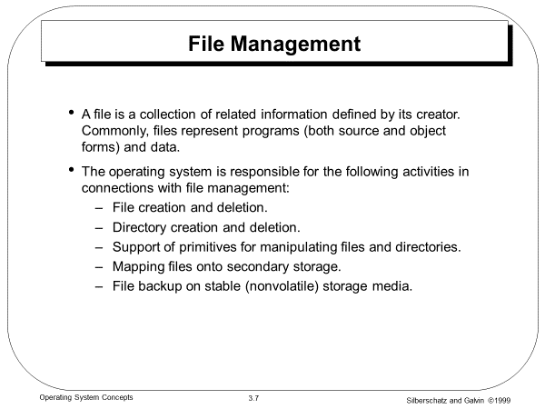

Slide 24
Protection System
Protection refers to a mechanism for controlling access by programs, processes, or users to both system and user resources.
The protection mechanism must:
  distinguish between authorized and unauthorized usage.
  specify the controls to be imposed.
  provide a means of enforcement.
Operating System Concepts

